Slide 1
Bank Management System
</
/>
Supervisor
Papia Akter, Lecturer,
CSE, Prime University
Team Members
Redwan Rashid Towsif (1089)
Ragib Barket (1067)
Mahamudul Hasan Pavel (1087)

Slide 2
</ Outline
Introduction
Objectives
Software Tools Used
Project Details
Conclusion
Future Improvements
Q&A

Slide 3
</ Introduction
This project is a bank management system that allows users to add, search, update, and delete accounts. It also allows users to deposit and withdraw funds. The target audience for this project is banks and financial institutions.
In this project, OOP is used to create the different classes of objects, such as the Account class and the BankManagementSystem class.

Slide 4
</ Objectives
Design and implement a bank management system using object-oriented programming principles.
Use data structures and algorithms to optimize the performance of the system.
Develop a user-friendly interface for the system.

Slide 5
</ Software Tools
The following software tools were used in this project:
Programming language: C++
IDE: Code Blocks

Slide 6
</ Implementation Details
In the core of our project is the Account class, which holds essential information like account number, name, password, balance.
The BankManagementSystem class manages critical functions such as adding accounts, searching, depositing, withdrawing, and more.

Slide 7
</ Key Functions
The addAccount() function creates a new account of the user.
The isAccountNumberUnique() ensures that every account number is unique.
With the searchAccount() function, users can locate accounts based on their account number and password.
To add funds, users utilize the depositFunds() function, which safely updates the account balance.
Withdrawals are managed through the withdrawFunds() function, which checks for sufficient account balance.
For an overview of all accounts, we use the displayAccounts() function.
The findAccount() function is responsible for searching for an account based on the provided account number and password.
Data persistence is achieved using the saveAccountsToFile() and loadAccountsFromFile() functions.

Slide 8
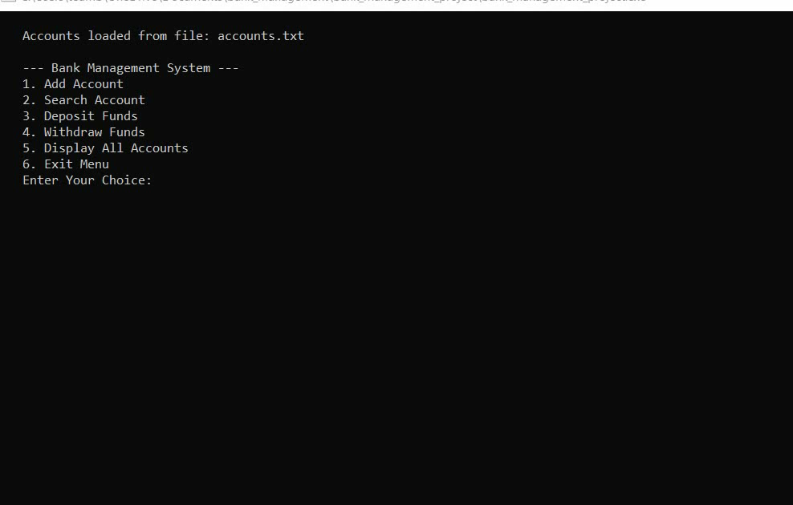
</ Demonstration Video

Slide 9
</ Future Improvements
The bank management system could be enhanced with additional features, such as the ability to transfer funds between accounts, the ability to set up recurring payments, and the ability to generate reports.
Here, we have implemented only basic feature logics to run the code in console, but in real-life use-case this system could be made more user friendly by improving the user interface. So, we could build a front-end application and connect that with the logics.
And to made it available for real-life users we could have a back-end server connected with SQL/No-SQL type databases to store the data’s more efficiently.

Slide 10
</ Conclusion
In summary, we have applied OOP principles effectively to create a robust and user-friendly system.
Looking ahead, future enhancements could include features like online banking and transaction history.
</ Reference
https://github.com/MH-PAVEL/bank_management_project
https://www.youtube.com/watch?v=MXiFFJl-4Q0

